Slide 1

Automated Industrial Inspection System Outline

Slide 2
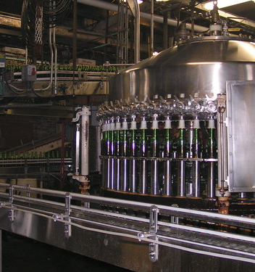
Agenda
Overview
Features and Techniques
Demo
Results
Challenges and Limitations
Future Steps
This Photo by Unknown author is licensed under CC BY-SA-NC.

Slide 3
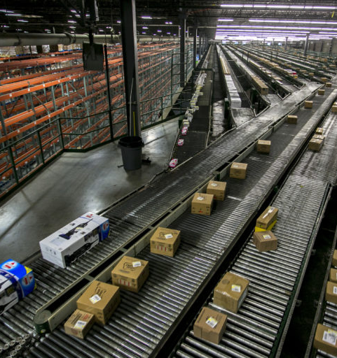
Overview
In today's manufacturing environment, maintaining high product quality is crucial. Manual defect detection is time-consuming, prone to errors, and inconsistent.
Automated defect detection systems leverage computer vision techniques to check if the product flow is right, identify defects and deformities in products, significantly improving quality control processes.
This Photo by Unknown author is licensed under CC BY-SA-NC.

Slide 4
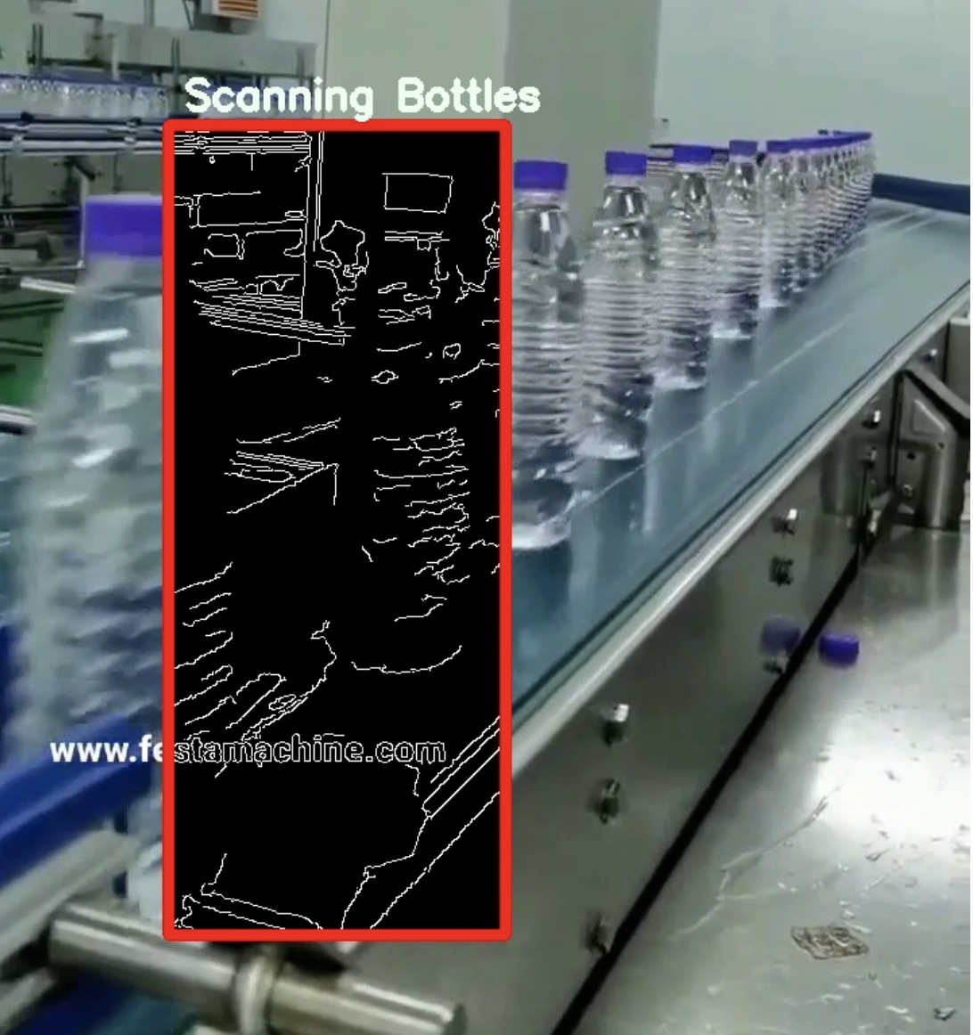
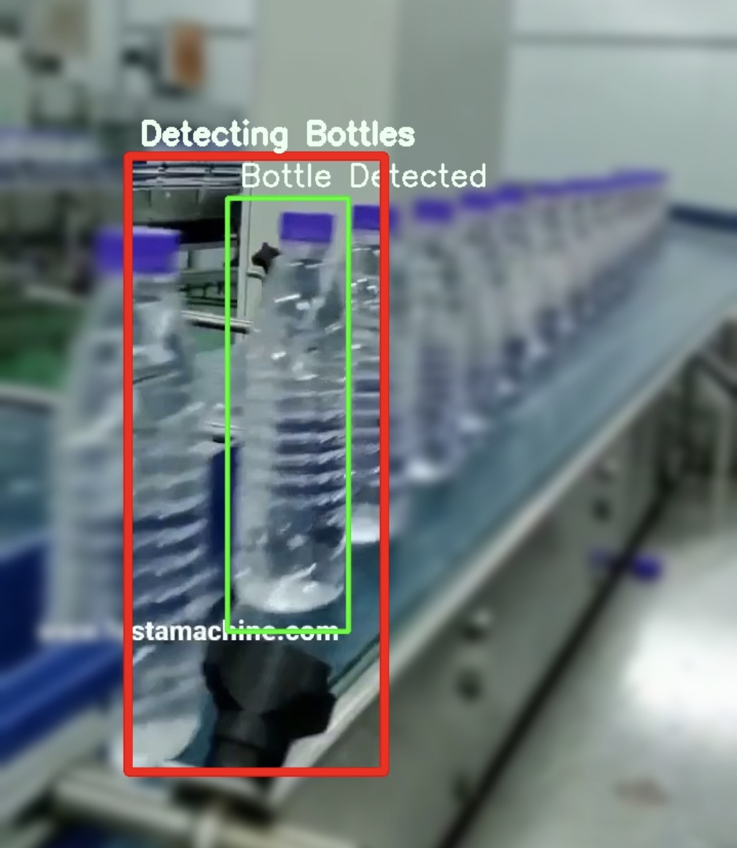
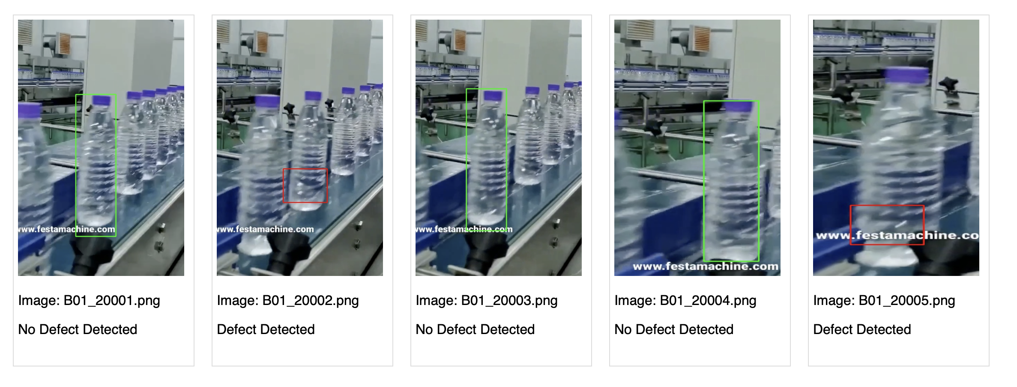
Features
Automated Industrial Inspection System consists of three main features:
Deformity Checker: This checks if there are any deformities in the shape of the product
Product Packaging Checker: This checks if the right number of products are being filled and packaged in the carton boxes
Defect Detector: This scans and identifies if any defects are present in the product
Deformity Checker
Product Packaging Checker
Defect Detection

Slide 5
Deformity Checker
Purpose:
Identify deformities in the product using object boundaries for verifying part dimensions and shapes.
Technique Used:
Extracted focus area from the video
Utilized Thresholding and Edge detector to highlight areas with significant changes in image intensity.
Denoised the bottle frame (erode and dilate)
Non-focus Area could be blurred or left as it is for performance improvements
Deformity Checker

Slide 6
Product Packaging Checker
Purpose:
This checks if the right number of products are being filled and packaged in the carton boxes
Technique Used:
Utilized an ensemble of image segment extractor, template matching and match redundancy remover to identify, trace and count the products on a specific region of the conveyor belt
Helps avoid void packaging, a common problem where empty/no product is packaged
Product Packaging Checker

Slide 7
Defect Detector
Purpose:
This scans all the images captured for a particular batch and classifies whether the product is defective or not
Utilized a multi-layer template matching architecture along with feature-based matching to compare parts against standard templates
Batch processes any folder that is given as an input
Technique Used:
First Layer checks if the product is defective and identifies only the region of defect
Second Layer checks if the product is non-defective and highlights the entire product
Defect Detector

Slide 8

Demo

Slide 9
Results
Benefits of Automation:
Reduces health and safety risks
Decreases operational costs and liability
Improves product quality
Helps reduce human bias
Economic Advantages:
Lowers labour costs
Reduces downtime and production delays
Fewer product defects and recalls
Enhances overall product quality and consistency

Slide 10
Challenges & Limitations
Bottles can come in various shapes, sizes, and colours. System must be adaptable for each design
Changes in lighting conditions, dust, and other environmental factors can affect the performance of the system
Integrating new vision systems with existing manufacturing and quality control processes can be complex
Speeds at which production lines operate require the system be capable of capturing and processing images quickly enough to keep up

Slide 11
Future Steps
Leverage deep learning models to improve the accuracy and versatility of the system by enabling them to learn from a broader set and adapt to new bottle designs.
Incorporate 3D imaging techniques to detect volumetric defects and the overall geometrical assessment , which are difficult to gauge using only 2D images.
IoT devices could be used to collect additional data from the manufacturing environment, such as temperature and humidity, to adjust the algorithms in real time.

Slide 12
Questions?

